Slide 1
Sparse PCA: Dealing with High Dimensional Data
Danny Vilenchik
The Weizmann Institute
Based on Joint works with Robi Krauthgamer and Boaz Nadler

Slide 2

Data Analytics
Sample a set of $p$ features (parameters) of $n$ observations
$p$–dimensional data
Goal: infer information from data
Height | Weight | Age
186 | 75 | 22
177 | 82 | 42
175 | 50 | 13

Slide 3
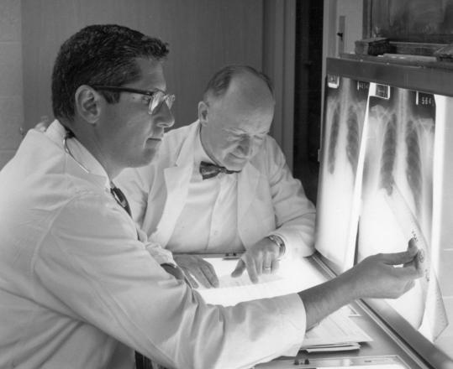
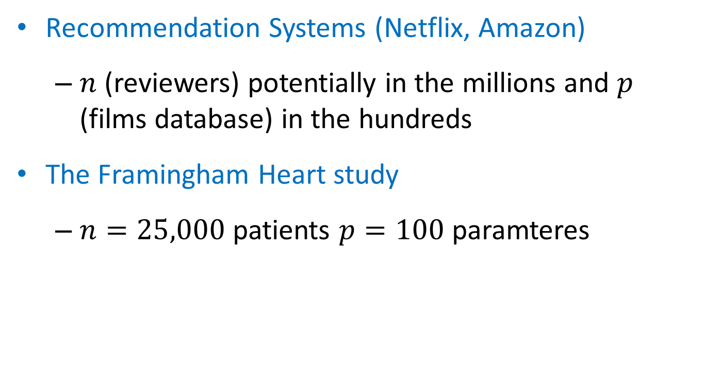
The Classical Setting
In the classical setting $p$is much smaller compared to $n$
Recommendation Systems (Netflix, Amazon)
$n$ (reviewers) potentially in the millions and $p$ (films database) in the hundreds
The Framingham Heart study
$n=25,000$ patients $p=100$ paramteres

Slide 4
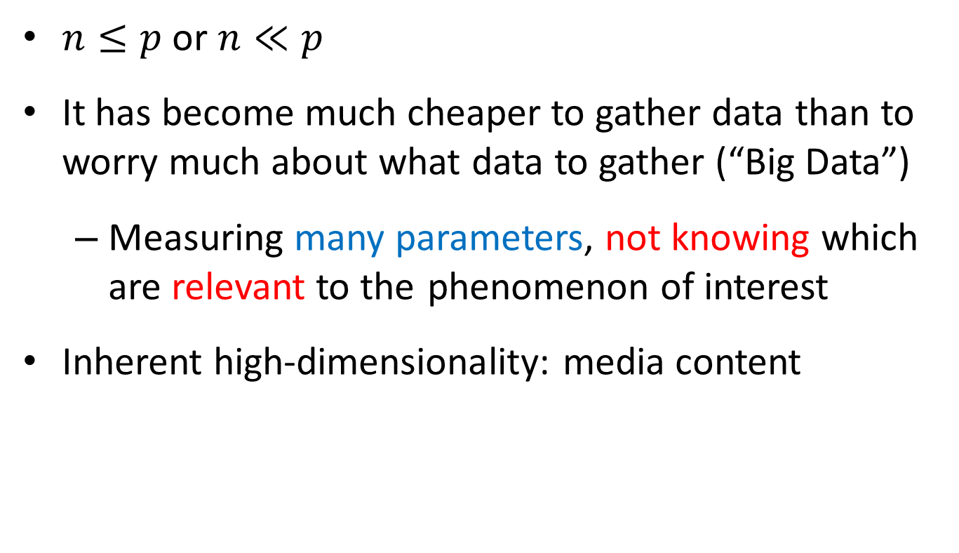
High Dimensional Setting
$n≤p$ or $n≪p$
It has become much cheaper to gather data than to worry much about what data to gather (“Big Data”)
Measuring many parameters, not knowing which are relevant to the phenomenon of interest
Inherent high-dimensionality: media content
Inference in this setting: needle in a hay stack

Slide 5
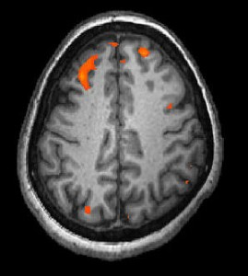
Examples
Biological Data: many genes few patients
MRI: many brain voxels few Hemodynamic response measurements

Slide 6
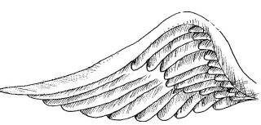
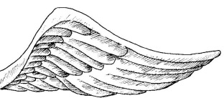
The Curse of Dimensionality
Inference with limited samples for very high-dimensional data
Most statistical tools break at this setting
The blessing of dimensionality
Real data is highly concentrate on low-dimensional structure in the high-dimensional space
Few variables explain the observed phenomena
But nothing is free: irrelevant measurements are ubiquitous in massive cheap data

Slide 7
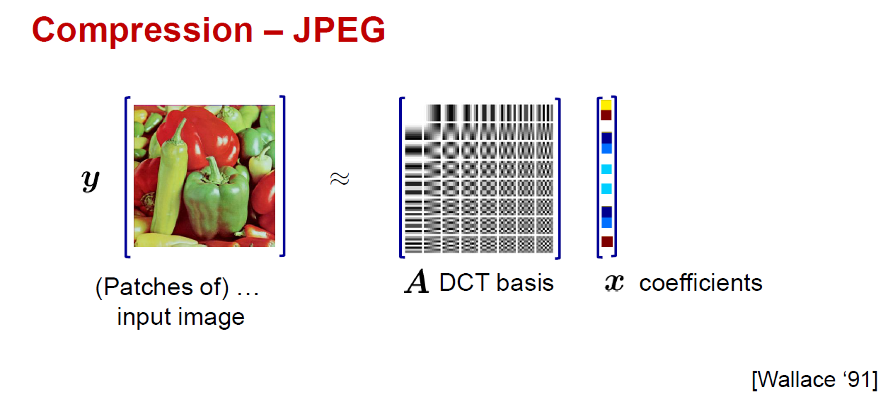
DCT viewed analytically as rotations of coordinate axes
DCT of media content often has several large transform coefficients and the rest are small
Rich local regularities, global symmetries, repetitive patterns

Slide 8
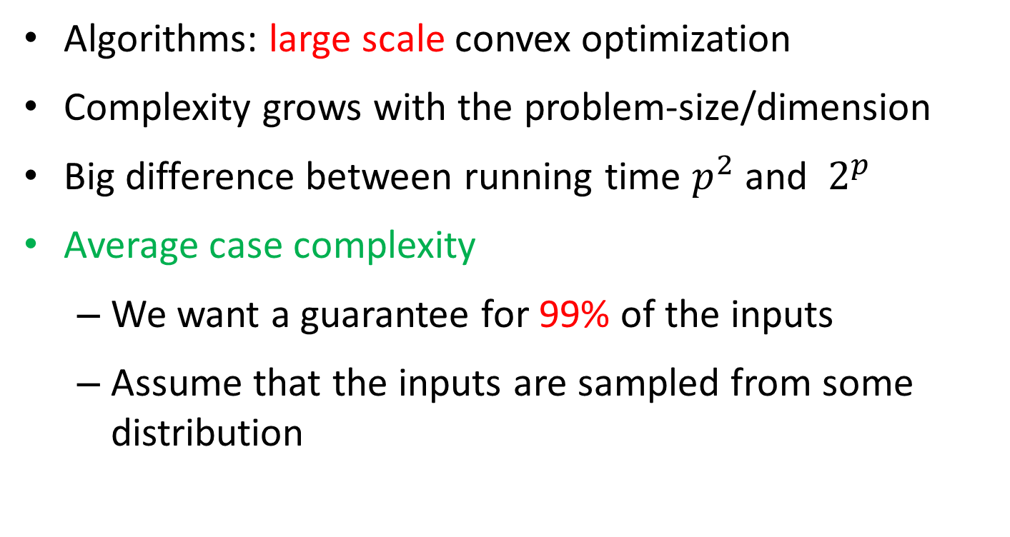
The Computational Lens
Algorithms: large scale convex optimization
Complexity grows with the problem-size/dimension
Big difference between running time $p^{2}$ and ${ 2}^{p}$
Average case complexity
We want a guarantee for 99% of the inputs
Assume that the inputs are sampled from some distribution

Slide 9
Today
Discuss Principal Component Analysis in the high-dimensional setting
Discuss algorithmic approaches to solve PCA
Information theoretical bounds
Efficiency
Sparisity assumptions

Slide 10
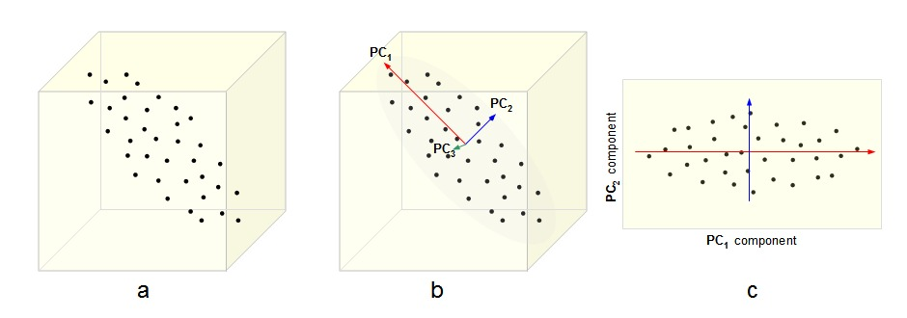
Principal Component Analysis (PCA)
In PCA we find the directions in which the variance is maximal
Projecting may reduce dimensionality of data

Slide 11
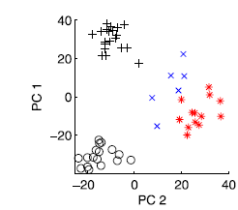
Four Types of Lung Cancer
Data set contains 56 lung cancer patients with 2530 genes

Slide 12
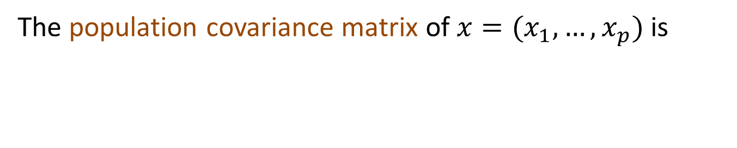
PCA – Formal Description
The first principal component (PC) of x is the direction a₁ in which variance is maximal
second PC:
The population covariance matrix of $x=(x_{1},…,x_{p})$ is
Leading eigenvector

Slide 13

The Algorithmic Task
Goal: Find the leading e/vector of the covariance matrix
Classical setting: $p≪n$:
High-dimensional setting: $n≤p$: no convergence
]Muirhead 82, Anderson 84]
[Johnstone`01,`04, Baik-Silverstein `06, Paul `07 and Nadler `08]

Slide 14
Sparse PCA
Information Theoretical aspect:
Computational:
This is not a convex program
NP-hard to solve it

Slide 15
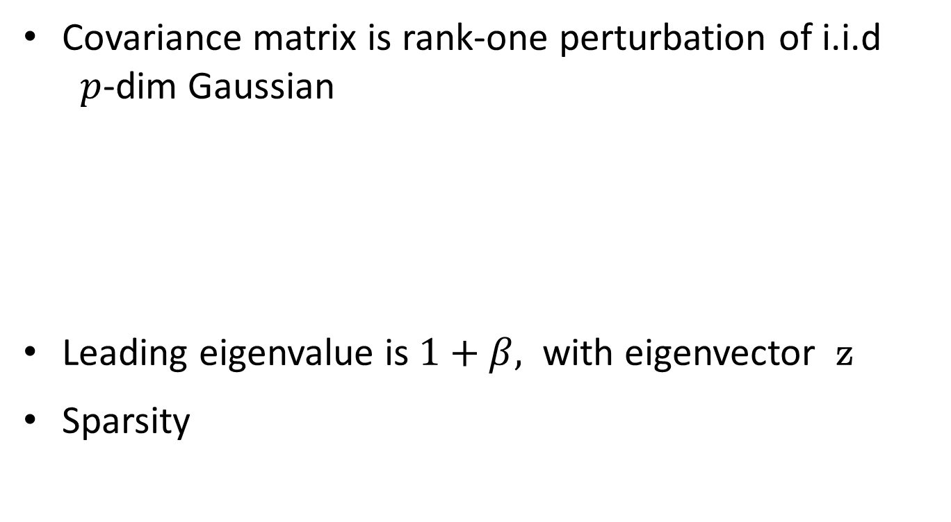
The Single Spike Model [Johnstone 2001]
Covariance matrix is rank-one perturbation of i.i.d $p$-dim Gaussian
Leading eigenvalue is $1+β,$ with eigenvector z
Sparsity
needle
haystack

Slide 16
Covariance Matrix
k
p-k
k
signal
mixed
p-k
mixed
NOISE

Slide 17
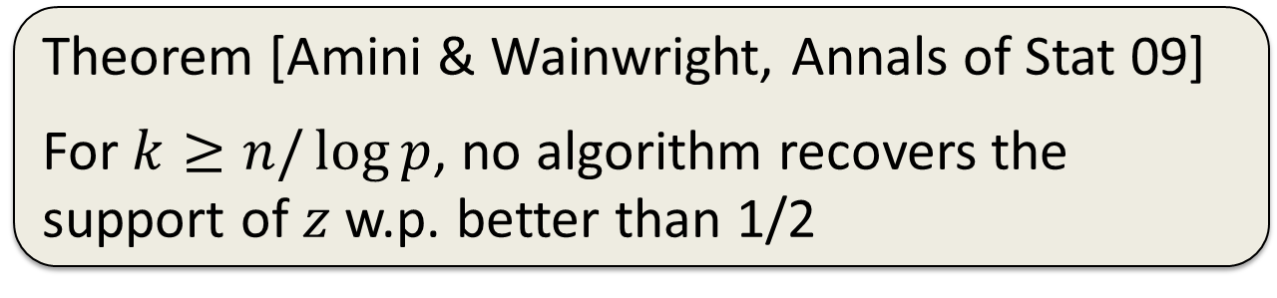
Questions of interest
Information limit:
Computational limit:
Up to what sparsity level k can one recover the planted spike?
Theorem [Amini & Wainwright, Annals of Stat 09]
For $k≥n/\log{p}$, no algorithm recovers the support of $z$ w.p. better than 1/2
Up to what sparsity level k can one efficiently recover the planted spike?

Slide 18


Naïve Approach
Go over all $k×k$submatrices ${\hat{Ʃ}}_{k}$
Compute largest eigenvalue of ${\hat{Ʃ}}_{k}$
Return the maximizer
Runtime: $p^{k}$

Slide 19

Greedy Approach
Return indices of $k$ largest diagonal entries in $\hat{Σ}$

Slide 20
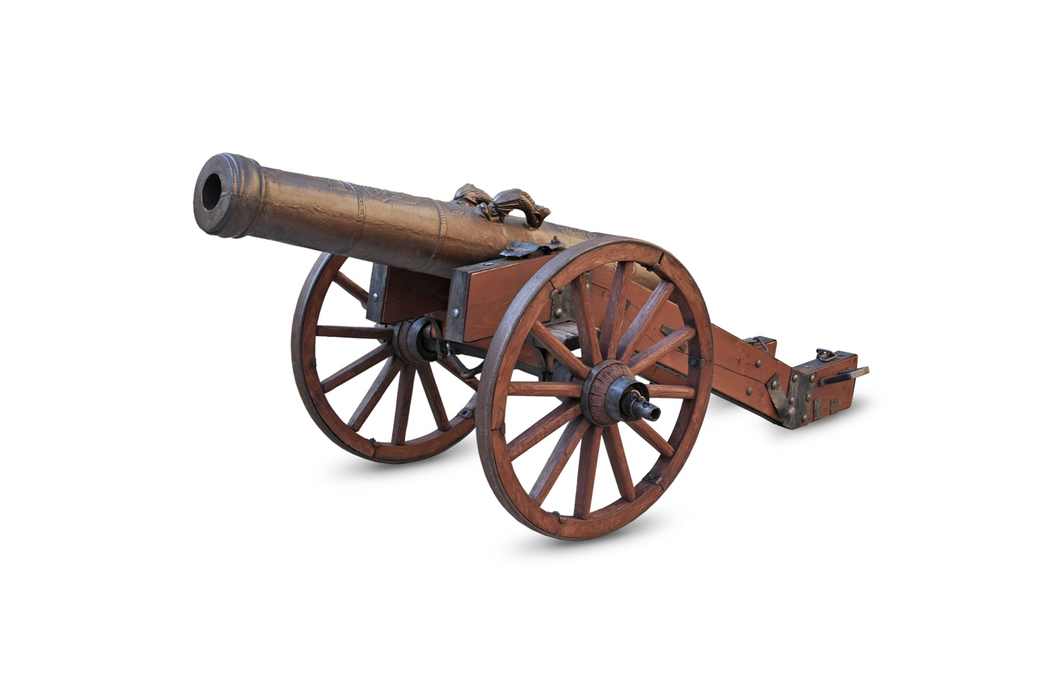
A heavier cannon?

Slide 21

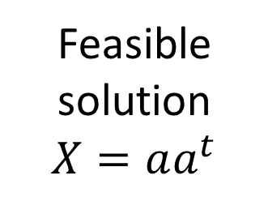
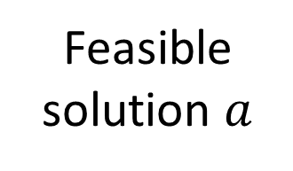
Semi-definite Programming Approach
Feasible solution $a$
SDP Relaxation
[d`Aspremont et al. 2004]
Feasible solution $X=aa^{t}$

Slide 22

SDP – Quick Facts
Semi-definite Programming is a generalization of Linear Programming
Can be solved efficiently in polynomial time: Ellipsoid method (up to arbitrary precision)
In practice, solving SDP is heavy
Is it justified to use it for solving sparse PCA?

Slide 23

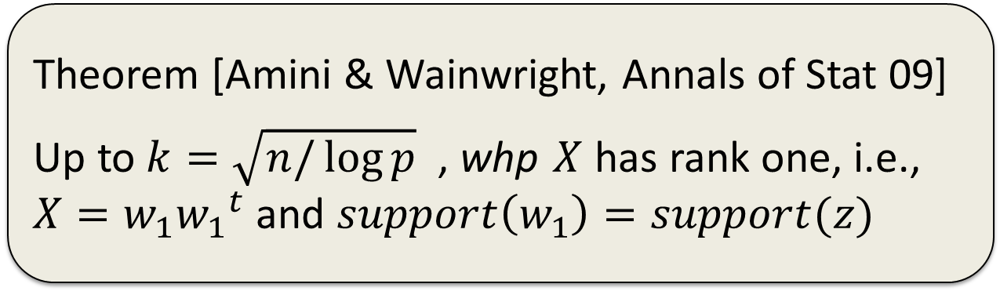

SDP Approach Contd.
1. Use an SDP-Solver to obtain $X$
2. Return its leading e/vector w₁
Theorem [Amini & Wainwright, Annals of Stat 09]
Up to $k=\sqrt{n/\log{p}}$ , whp $X$ has rank one, i.e., $X=w_{1}{w_{1}}^{t}$ and $support\left(w_{1}\right)=support(z)$
Recall that the information limit is $k≥n/\log{p}$

Slide 24
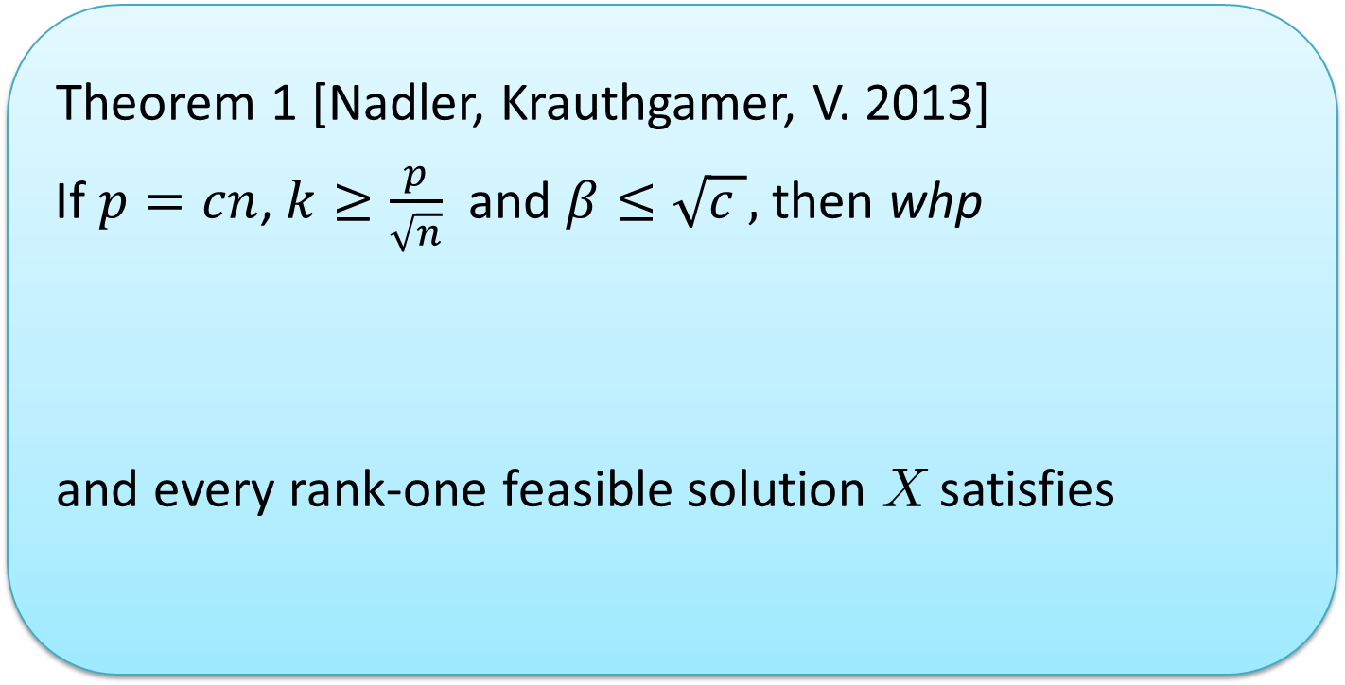
Our Results
Theorem 1 [Nadler, Krauthgamer, V. 2013]
If $p=cn$, $k≥\frac{p}{\sqrt{n}}$ and $β≤\sqrt{c },$then whp
and every rank-one feasible solution X satisfies

Slide 25
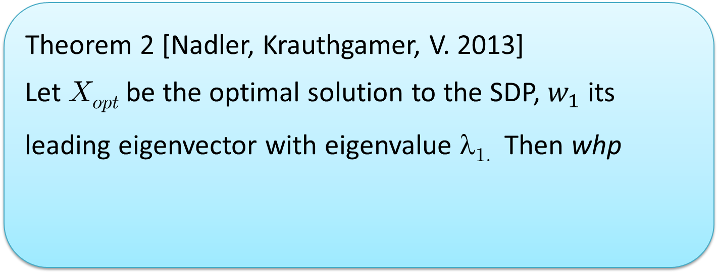
Our Results
Theorem 2 [Nadler, Krauthgamer, V. 2013]
Let X_{opt} be the optimal solution to the SDP, $w_{1}$ its leading eigenvector with eigenvalue λ_{1.} Then whp
In other words, low-rank solutions are not informative

Slide 26
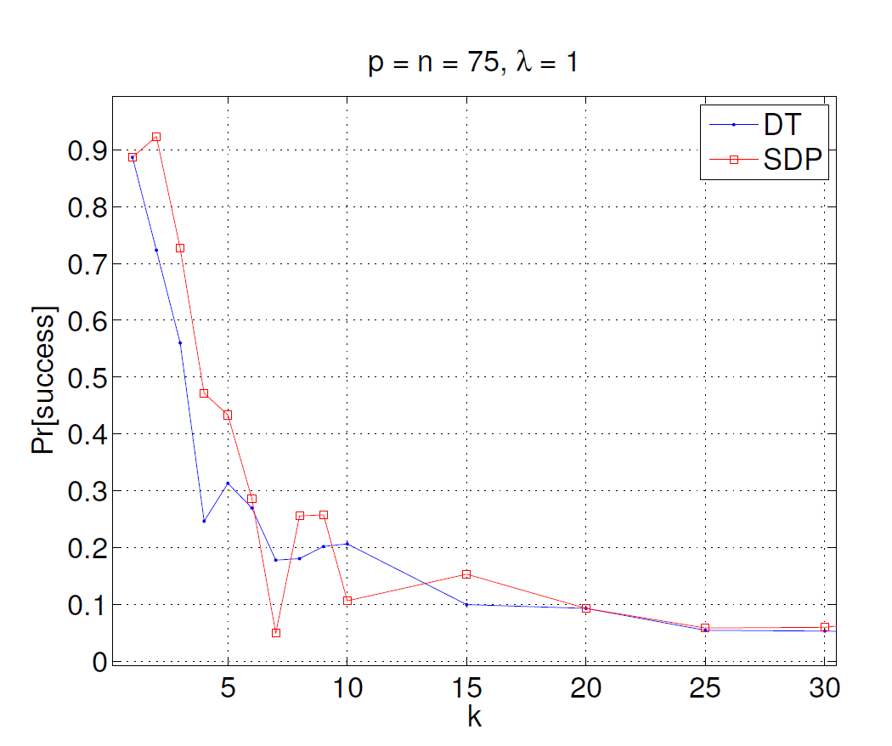
Diagonal Thresholding vs. SDP

Slide 27
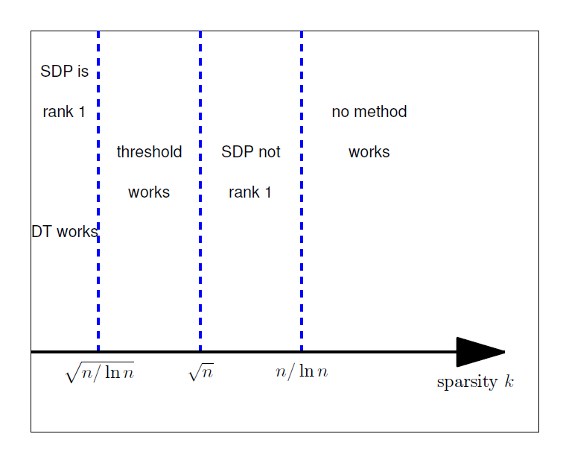


Slide 28

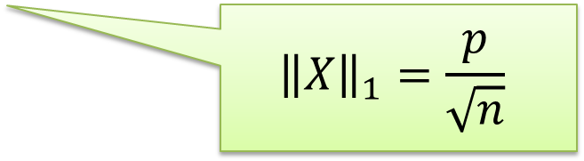
Proof Ideas
“Guess” a solution X to the SDP
Show that X is feasible (${\left\|X\right\|}_{1}≤k$)
Compute its value
$${\left\|X\right\|}_{1}=\frac{p}{\sqrt{n}}$$
Signal part
0
0 0 0
0 0 0 0 0 0
Mixed Signal-Noise
X
Noise

Slide 29
Covariance Thresholding
Compute the sample covariance matrix
Zero off-diagonal entries with value < t
Return leading eigenvector w₁ of the thresholded matrix
How to choose t?
Expected gap between noise and signal part is β/k

Slide 30
Experimental Results

Slide 31
Experimental Results

Slide 32
CT works

Slide 33
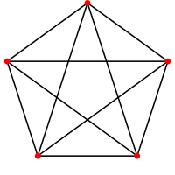
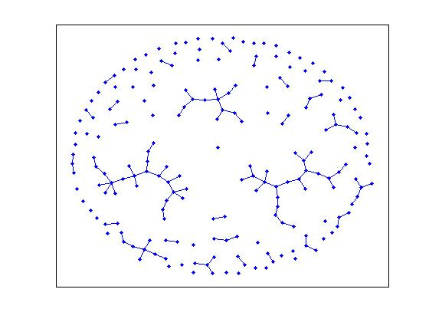


The Planted Clique
$$p=\frac{1}{2}$$

Slide 34
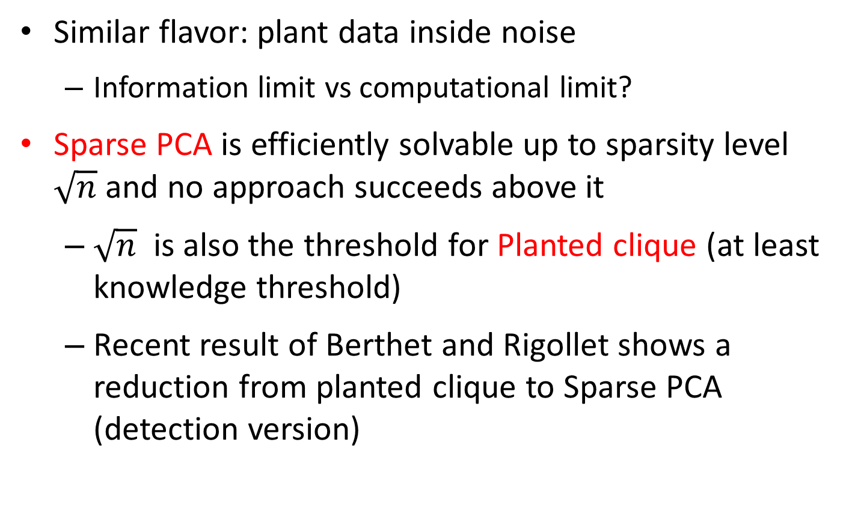
Connection with Planted Clique
Similar flavor: plant data inside noise
Information limit vs computational limit?
Sparse PCA is efficiently solvable up to sparsity level $\sqrt{n}$ and no approach succeeds above it
$\sqrt{n}$ is also the threshold for Planted clique (at least knowledge threshold)
Recent result of Berthet and Rigollet shows a reduction from planted clique to Sparse PCA (detection version)

Slide 35
Future Research
Which structural properties of the input make hard problems tractable?
Which efficient methods work in this case?
Under what assumptions do SDP have optimal integral solutions
Using SDP to solve graph colorings (clustering)
Relate integrality of a certain SDP to rigidity of geometrical bodies

